Slide 1
2.
A) Reading Data
B) Advanced Querying
C) Updating Data
D) Deleting Data
E) Insert Trigger

Slide 2
2.
F) Delete Trigger
G) Update Trigger
H) ON CASCADE

Slide 3
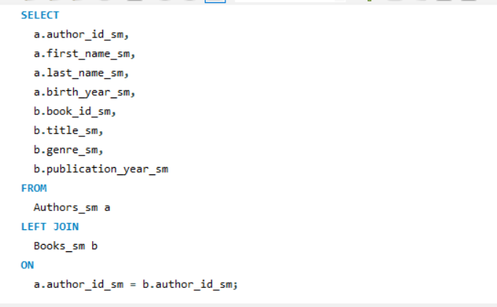
2A ) Reading Data
This query retrieves all authors along with their associated books using a LEFT JOIN.
It ensures that every author is listed even if they have no corresponding books, making it essential for comprehensive data retrieval in a one-to-many relationship.

Slide 4
SELECT
a.author_id_sm,
a.first_name_sm,
a.last_name_sm,
a.birth_year_sm,
b.book_id_sm,
b.title_sm,
b.genre_sm,
b.publication_year_sm
FROM
Authors_sm a
LEFT JOIN
Books_sm b
ON
a.author_id_sm = b.author_id_sm;

Slide 5
SELECT
b.title_sm,
b.genre_sm,
a.first_name_sm,
a.last_name_sm
FROM
Books_sm b
JOIN
Authors_sm a
ON
b.author_id_sm = a.author_id_sm;
SELECT
*
FROM
Books_sm
WHERE
genre_sm = 'Fiction';

Slide 6
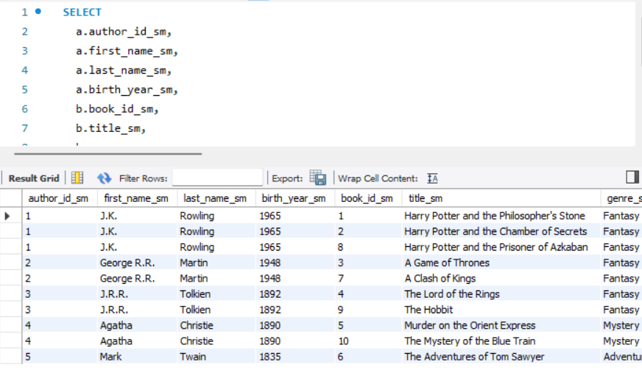

Slide 7
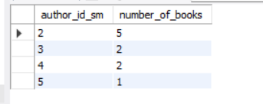
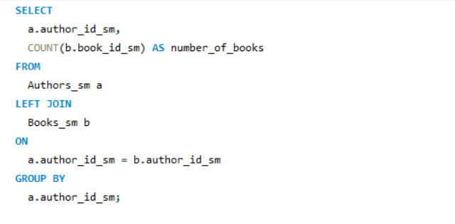
2B ) Advanced Querying
i ) Aggregate Function Query
This query counts the number of books each author has written, using COUNT and GROUP BY to aggregate the data.
It’s useful for summarizing data in a one-to-many relationship.

Slide 8
SELECT
a.author_id_sm,
COUNT(b.book_id_sm) AS number_of_books
FROM
Authors_sm a
LEFT JOIN
Books_sm b
ON
a.author_id_sm = b.author_id_sm
GROUP BY
a.author_id_sm;

Slide 9
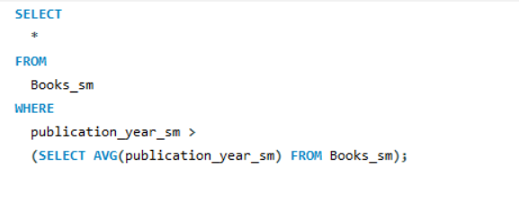
ii ) Query with a Subquery
This query selects books published after the average publication year. The subquery calculates the average, and the main query uses this to filter results.

Slide 10
ii ) Query with a Subquery
SELECT
*
FROM
Books_sm
WHERE
publication_year_sm >
(SELECT AVG(publication_year_sm) FROM Books_sm);

Slide 11
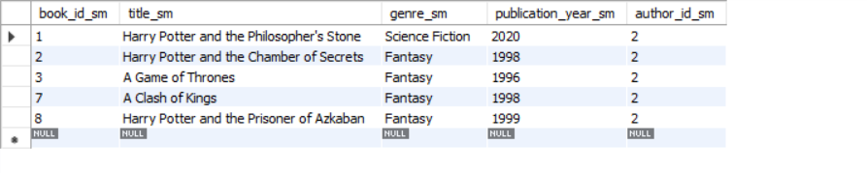

Slide 12
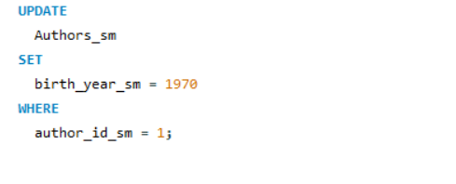
2C) Updating Data
i ) Update a Specific Attribute in the "Parent" Table
This query updates the birth year of a specific author. It’s essential for correcting or modifying data within the parent table.

Slide 13
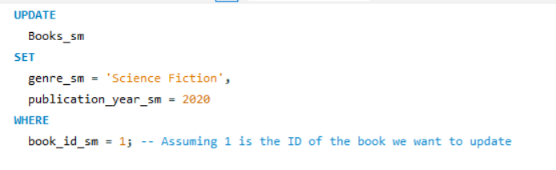
Using draw.io
ii ) Update Multiple Attributes in the "Child" Table
This query updates both the genre and publication year of a specific book, demonstrating how to modify multiple attributes in a single operation.

Slide 14
a) Update a Specific Attribute in the "Parent" Table
UPDATE
Authors_sm
SET
birth_year_sm = 1970
WHERE
author_id_sm = 1;
b) Update Multiple Attributes in the "Child" Table
UPDATE
Books_sm
SET
genre_sm = 'Science Fiction',
publication_year_sm = 2020
WHERE
title_sm = 'Some Book Title';

Slide 15
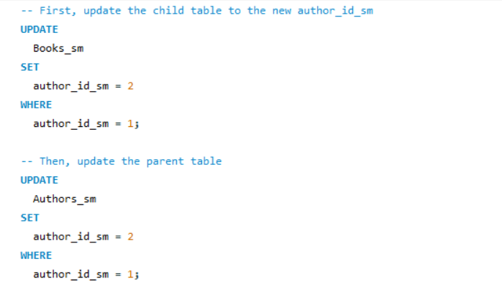
iii) Cascading Updates
This ensures that the foreign key constraint is not violated when updating the author_id_sm in the Authors_sm table.
It changes the author ID and automatically updates the related books’ author IDs. If cascading updates aren’t supported, manual updates would be required.

Slide 16
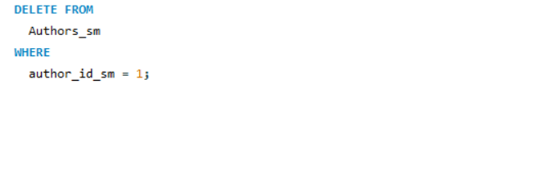
2D ) Deleting Data
i) Delete a Specific Record from the "Parent" Table
This query deletes an author and examines the impact on related books. If cascading deletes aren’t enabled, manual cleanup of orphaned records may be necessary.

Slide 17
i) Delete a Specific Record from the "Parent" Table
i) Delete a Specific Record from the "Parent" Table
DELETE FROM
Authors_sm
WHERE
author_id_sm = 1;

Slide 18
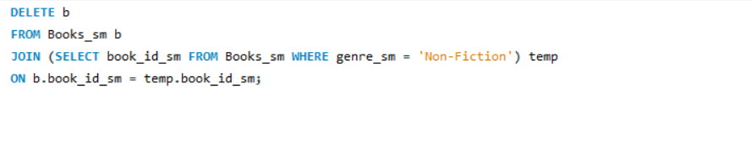
ii ) Delete Specific Records from the "Child" Table
This query removes all books of a specific genre. It demonstrates how to delete child records based on a condition.

Slide 19
i) Delete a Specific Record from the "Parent" Table
i) Delete a Specific Record from the "Child" Table
DELETE FROM
Books_sm
WHERE
genre_sm = 'Non-Fiction';

Slide 20
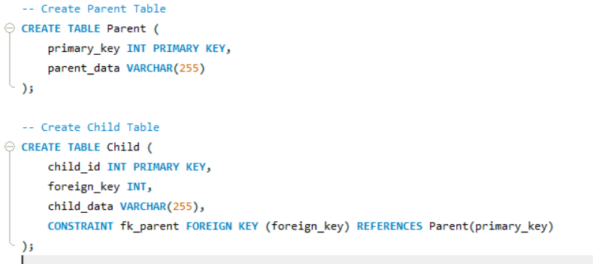
2E ) Inserting Trigger
i) Delete a Specific Record from the "Parent" Table
This query deletes an author and examines the impact on related books. If cascading deletes aren’t enabled, manual cleanup of orphaned records may be necessary.

Slide 21
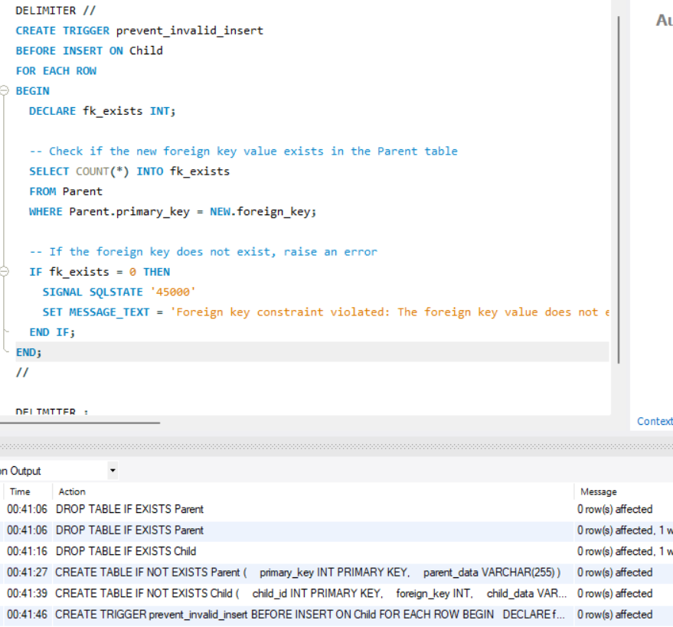

Slide 22
DELIMITER //
CREATE TRIGGER prevent_invalid_insert
BEFORE INSERT ON Child
FOR EACH ROW
BEGIN
DECLARE fk_exists INT;
-- Check if the new foreign key value exists in the Parent table
SELECT COUNT(*) INTO fk_exists
FROM Parent
WHERE Parent.primary_key = NEW.foreign_key;
-- If the foreign key does not exist, raise an error
IF fk_exists = 0 THEN
SIGNAL SQLSTATE '45000'
SET MESSAGE_TEXT = 'Foreign key constraint violated: The foreign key value does not exist in the Parent table.';
END IF;
END;
//
DELIMITER ;

Slide 23
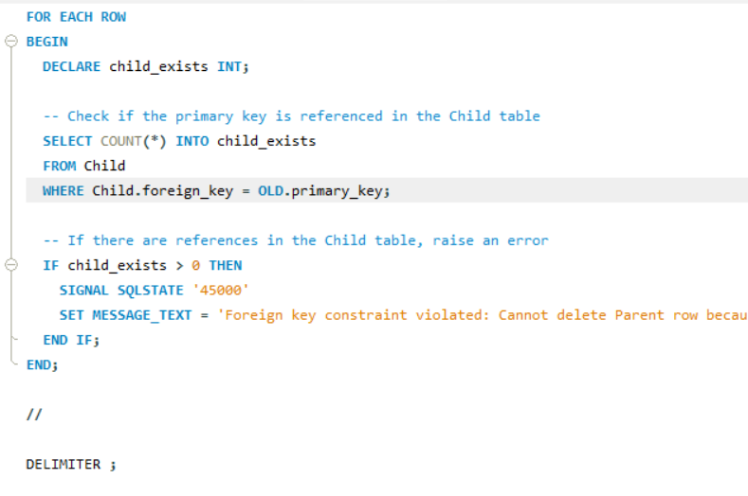
2E) Deleting Trigger

Slide 24
Successful deletion

Slide 25
DELIMITER //
CREATE TRIGGER prevent_invalid_delete
BEFORE DELETE ON Parent
FOR EACH ROW
BEGIN
DECLARE child_exists INT;
-- Check if the primary key is referenced in the Child table
SELECT COUNT(*) INTO child_exists
FROM Child
WHERE Child.foreign_key = OLD.primary_key;
-- If there are references in the Child table, raise an error
IF child_exists > 0 THEN
SIGNAL SQLSTATE '45000'
SET MESSAGE_TEXT = 'Foreign key constraint violated: Cannot delete Parent row because it is referenced in the Child table.';
END IF;
END;
//
DELIMITER ;

Slide 26
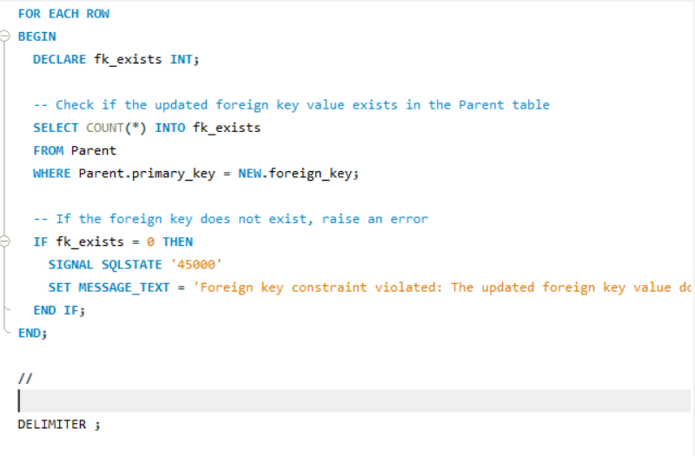
2F ) Update Trigger
I ) Trigger on Child Table:

Slide 27
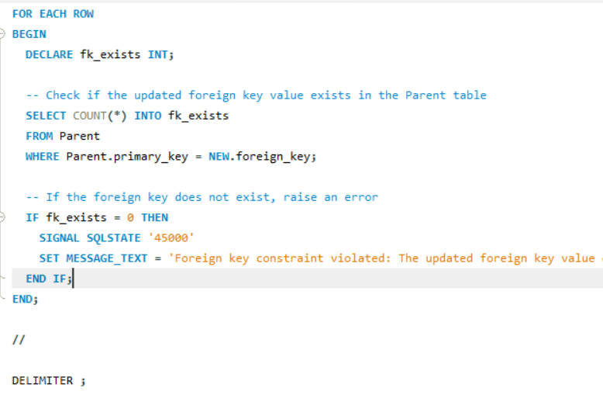
ii ) Trigger on Parent Table:

Slide 28
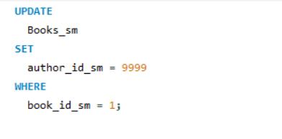
a) Testing the Trigger
Test Case 1: Attempt to update author_id_sm in Books_sm to a non-existing value.
This query should fail with an error indicating that the author_id_sm does not exist in Authors_sm.

Slide 29
DELIMITER //
CREATE TRIGGER prevent_invalid_fk_update
BEFORE UPDATE ON Child
FOR EACH ROW
BEGIN
DECLARE fk_exists INT;
-- Check if the updated foreign key value exists in the Parent table
SELECT COUNT(*) INTO fk_exists
FROM Parent
WHERE Parent.primary_key = NEW.foreign_key;
-- If the foreign key does not exist, raise an error
IF fk_exists = 0 THEN
SIGNAL SQLSTATE '45000'
SET MESSAGE_TEXT = 'Foreign key constraint violated: The updated foreign key value does not exist in the Parent table.';
END IF;
END;
//
DELIMITER ;

Slide 30
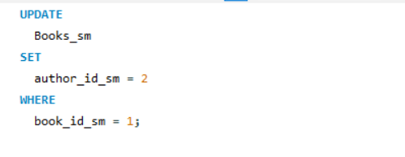
b) Testing the Trigger
Test Case 2: Successfully update author_id_sm to an existing value.
The update should succeed if author_id_sm = 2 exists in Authors_sm.

Slide 31
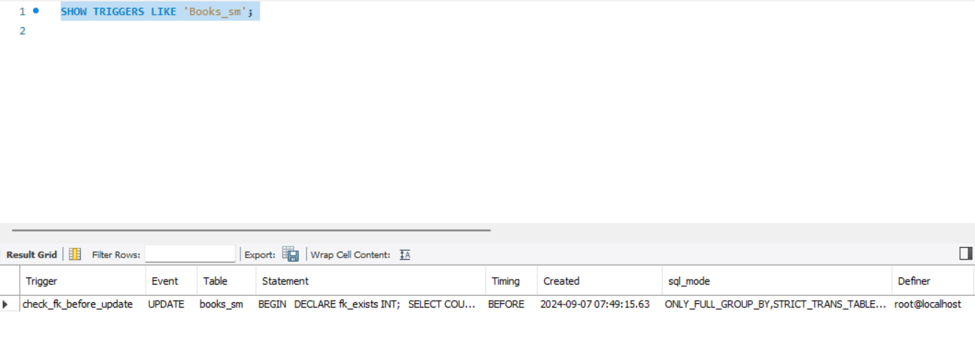
Verifying Trigger Execution

Slide 32
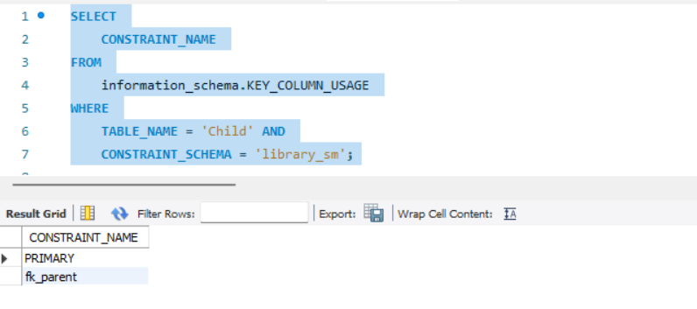
2H ) ON CASCADE : ON UPDATE CASCADE:
Check Existing Foreign Key Constraints: You need to check the existing foreign key constraints on the Child table.

Slide 33

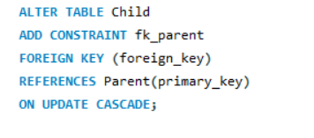


Slide 34
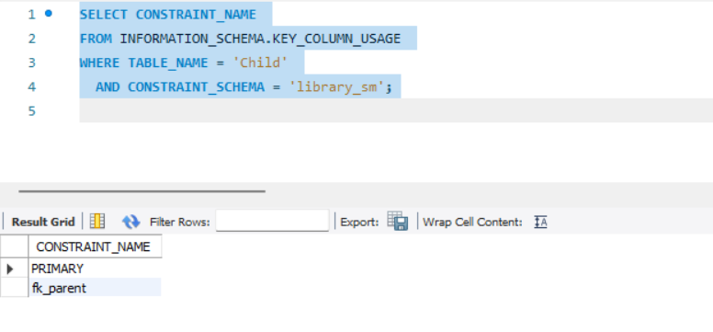
2H ) ON CASCADE : ON DELETECASCADE:

